Slide 1
Egocentric Whole-Body Motion Capture with FisheyeViT and Diffusion-Based
Motion Refinement
CVPR 2024
Notes:
Instead of attempting to undistort the entire fisheye image, which is impractical due to the fisheye lens’s large field of view (FOV), we opt to partition the image into smaller patches aligned with a specific FOV range. This approach enables individual patch-level undistortion and seamlessly aligns with the vision transformer architecture that is employed for extracting the complete image feature map.
Unlike the existing approach [52] that projects image features into 3D space through fisheye reprojection functions and regresses 3D heatmaps with V2V networks [33] leading to intricate network learning and high computational complexity–our proposed egocentric pose regressor adopts a simpler approach. It employs deconvolutional layers to obtain pixel-aligned 3D heatmaps. Notably, the voxels in the 3D heatmap directly correspond to pixels in 2D features, subsequently linking to image patches in FisheyeViT.
To overcome the challenges posed by self-occlusion and improve the accuracy of pose estimation, we propose a novel method for refining the whole-body motion predictions by incorporating temporal context and a motion prior.
Uncertainty-aware refinement method based on motion diffusion models for correcting initial pose estimations and predicting plausible motions even under occlusion;
In response to the absence of the egocentric whole-body motion capture datasets, we present EgoWholeBody, a new large-scale high-quality synthetic dataset.
However, stereo camera setups introduce extra burdens of weight and energy consumption.
We notice that the single-frame estimations in Sec. 3.1 suffer from inaccuracies and temporal instabilities. In this section, we propose a diffusion-based motion refinement method to tackle this problem

Slide 2
Contributions
A pipeline for egocentric whole-body motion capture
Introducing FisheyeVIT to handle fisheye distortion effectively
Use of a diffusion denoiser for skeletal point refinement
Introducing the EgoWholeBody dataset

Slide 3
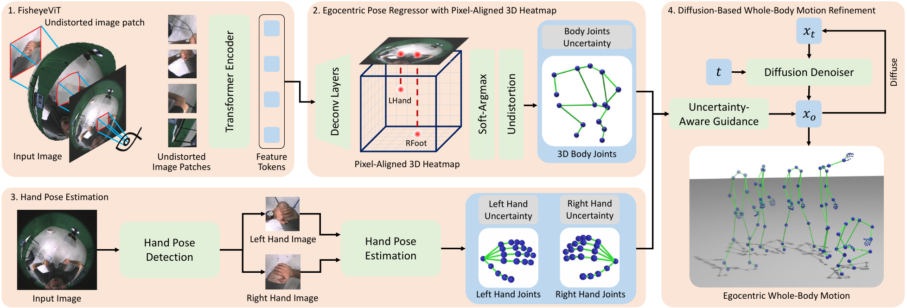
Pipeline
Figure 2

Slide 4
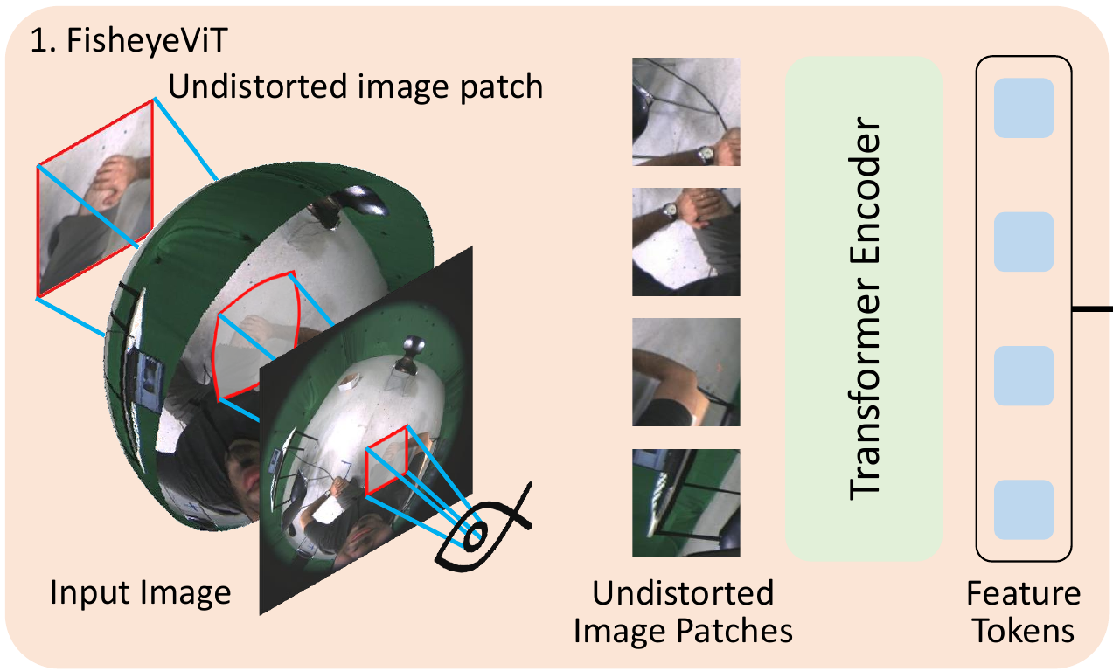
FisheyeViT
Different from base ViT in the patching step
FOV and uv coordinates of the patch affects the distortion model
Each patch is undistorted separately
Figure 2

Slide 5
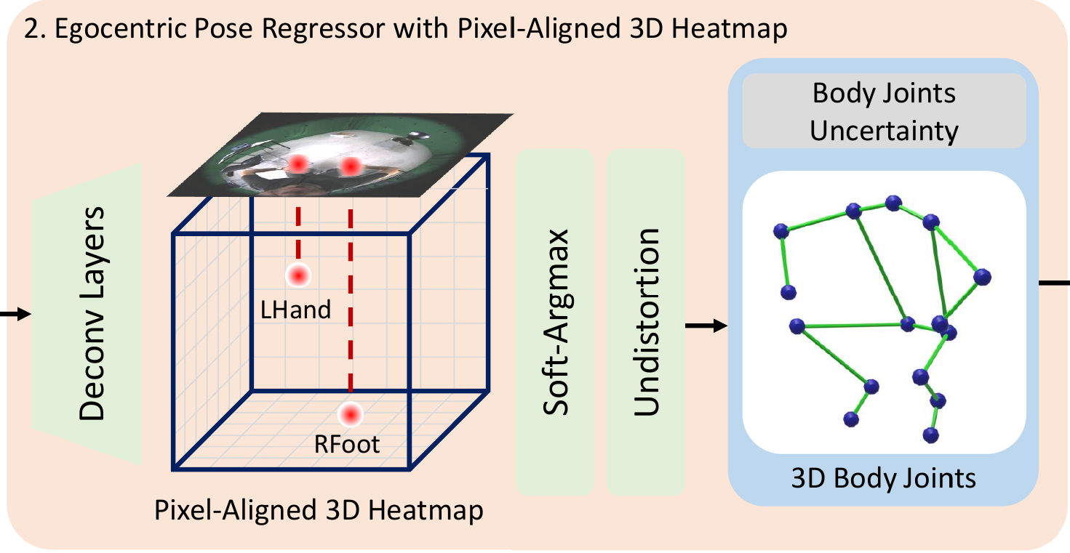
Body Joint Regression
Use uvd space instead of xyz to align the features with the pixel space
Deconv layer:
Channels x Patches to Depth x Joints x H x W
uvd to xyz using fisheye projection
Figure 2

Slide 6
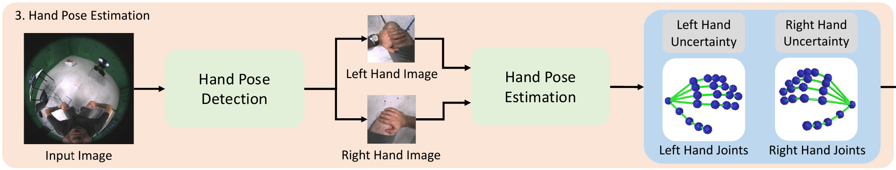
Hand Pose Estimation
Fine-tuned an HRNet to regress 2D left and right hand center and bounding box
Cropped hand image is undistorted similar to their patch undistortion method
Get 3D hand pose using the Hand4Whole [34] model
- Figure 2
- [34] Moon, G., Choi, H., & Lee, K. M. (2022). Accurate 3D hand pose estimation for whole-body 3D human mesh estimation. In Proceedings of the IEEE/CVF Conference on Computer Vision and Pattern Recognition (pp. 2308-2317).

Slide 7
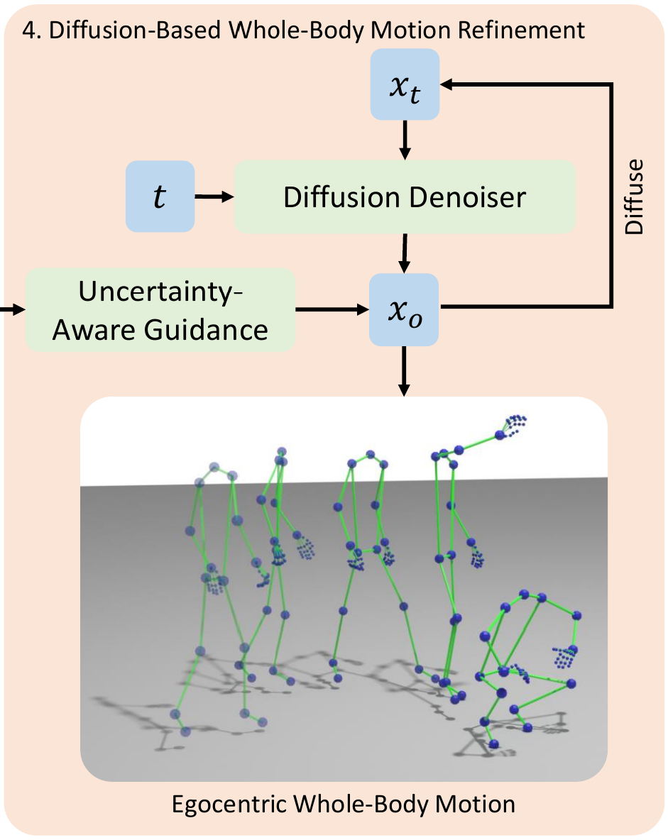
Diffusion Pose Refinement
The diffusion denoiser is pre-trained on human motion and acts as human motion prior
Reconstruct low-certainty joints based on the high-certainty joints using the diffusion denoiser
- Figure 2

Slide 8
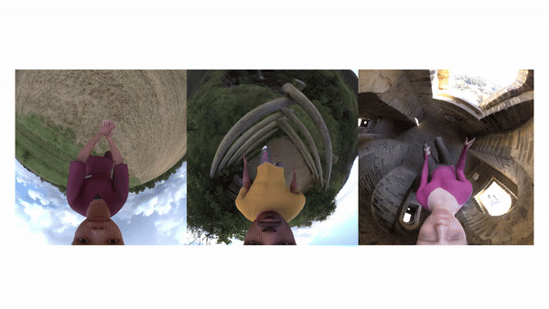
EgoWholeBody dataset
700k synthetic frames
14 renderpeople
2367 Mixamo motions
170k hand motion using SMPL-X
262 GRAB [46] and TCDHandMocap [20] motions
- https://people.mpi-inf.mpg.de/~jianwang/projects/egowholemocap/
- [20] Hoyet, L., Ryall, K., McDonnell, R., & O'Sullivan, C. (2012, March). Sleight of hand: perception of finger motion from reduced marker sets. In Proceedings of the ACM SIGGRAPH symposium on interactive 3D graphics and games (pp. 79-86).
- [46] Taheri, O., Ghorbani, N., Black, M. J., & Tzionas, D. (2020). GRAB: A dataset of whole-body human grasping of objects. In Computer Vision–ECCV 2020: 16th European Conference, Glasgow, UK, August 23–28, 2020, Proceedings, Part IV 16 (pp. 581-600). Springer International Publishing.

Slide 9
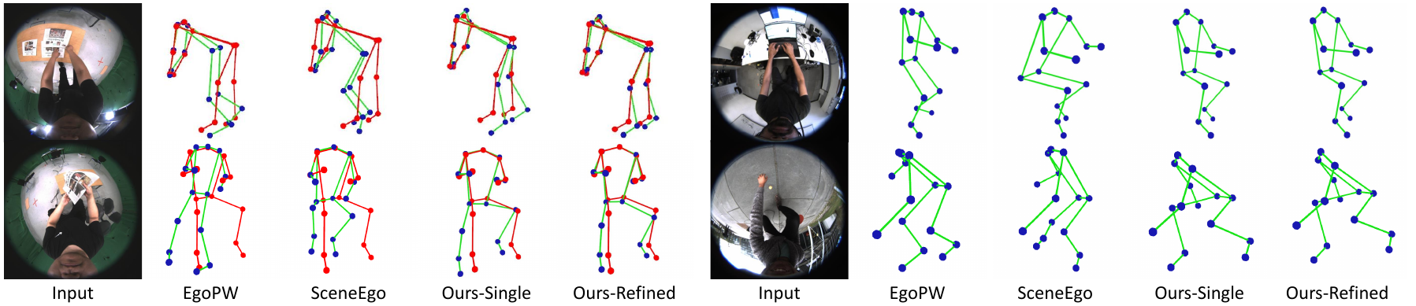
Qualitative Evaluation (0)

Slide 10
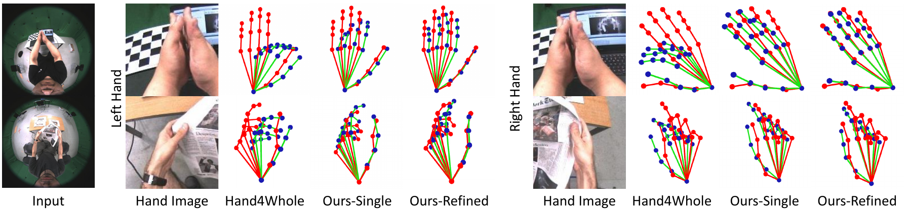
Qualitative Evaluation (1)

Slide 11
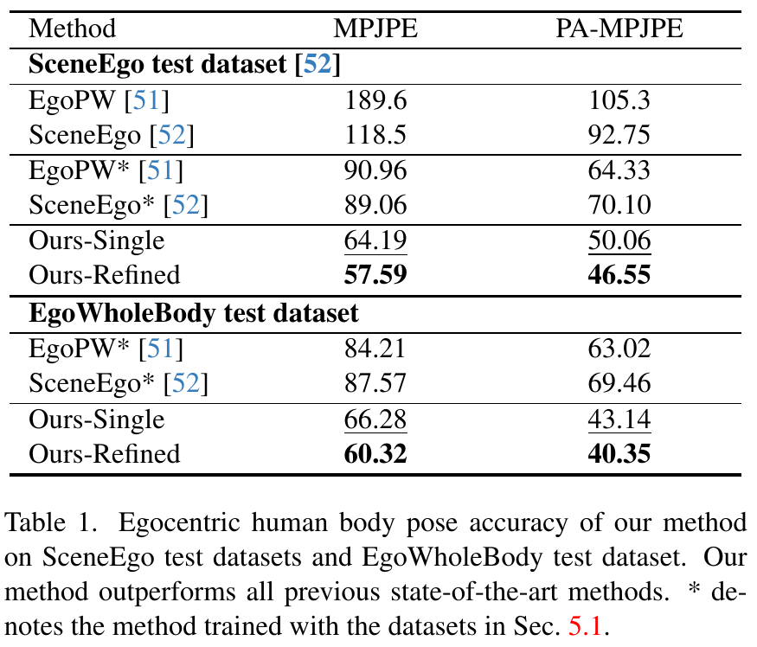
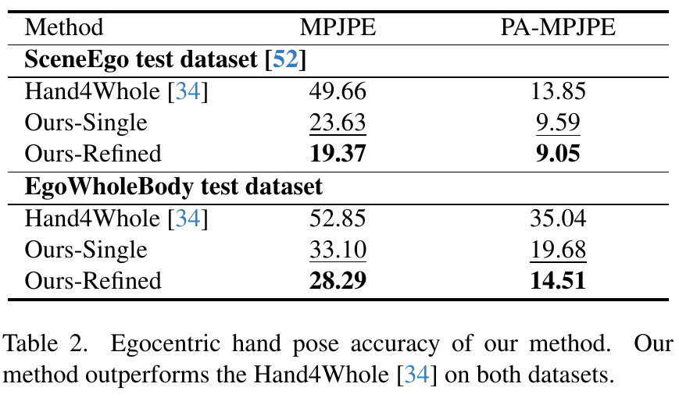
Quantitative Evaluation

Slide 12
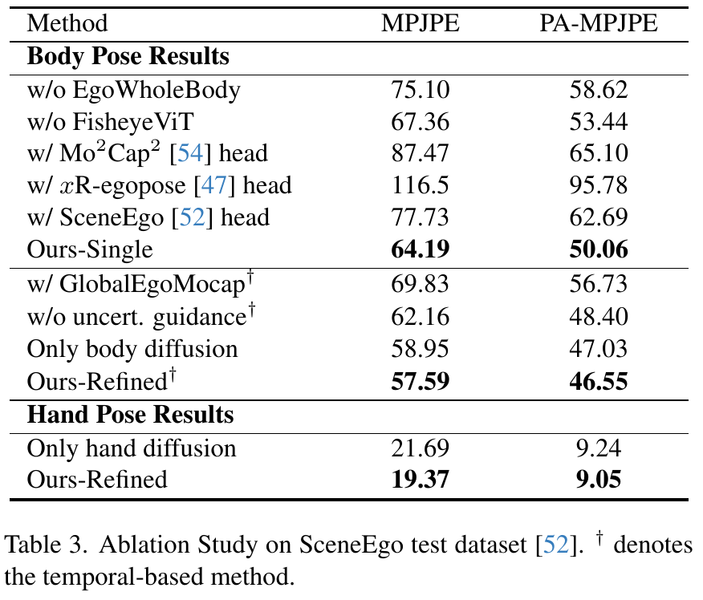
Ablation Study
Temporal diffusion refinement significantly reduces the pose estimation error
Joint learning of body and hand joints improve diffusion refinement

Slide 13
THANKS!

